Slide 1
Reinforcement Learning-I

Slide 2
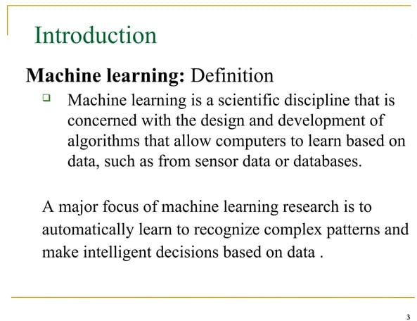

Slide 3
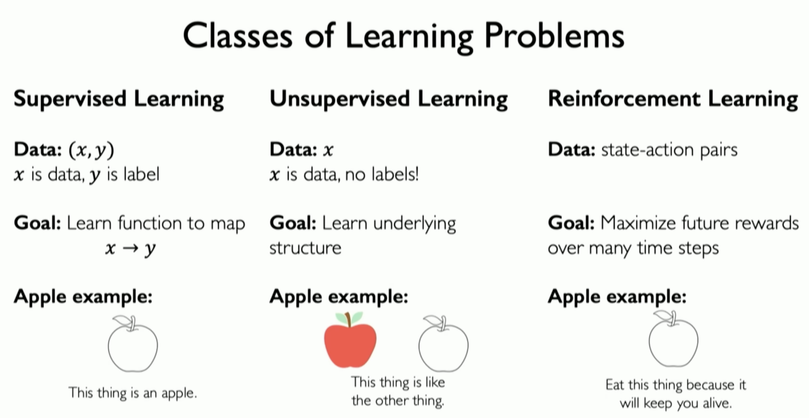

Slide 4
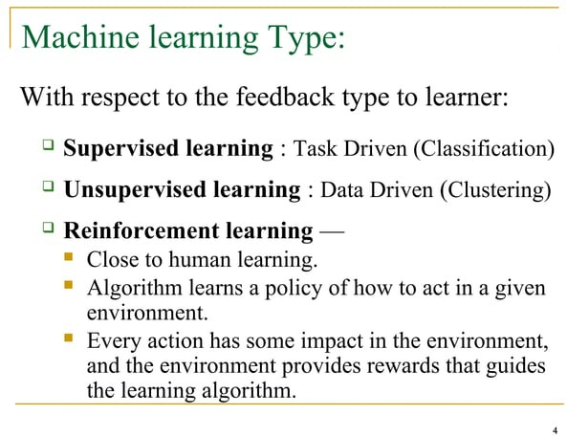

Slide 5
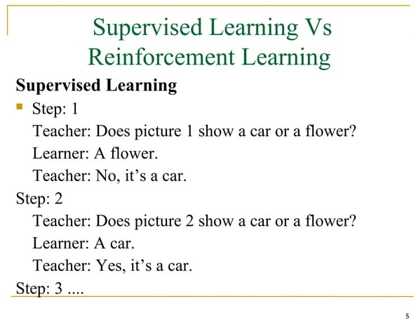

Slide 6
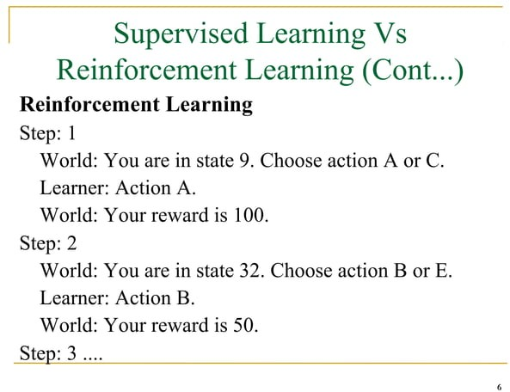

Slide 7
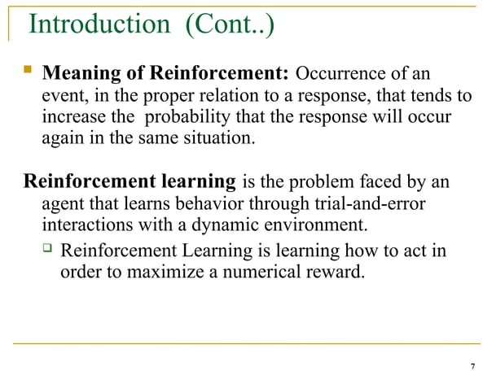

Slide 8
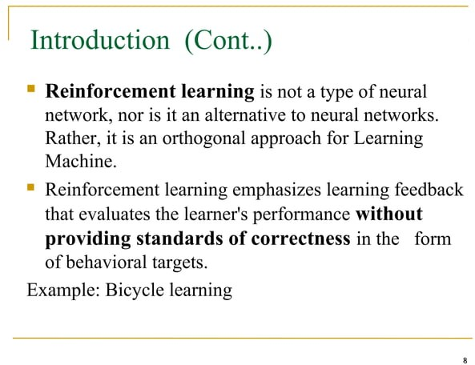

Slide 9
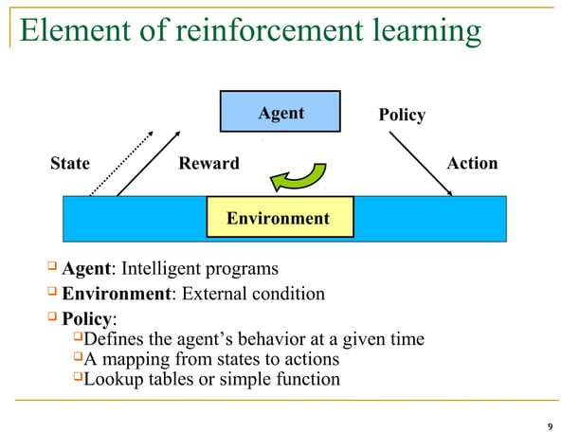

Slide 10
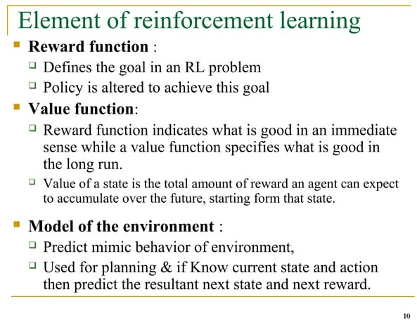

Slide 11
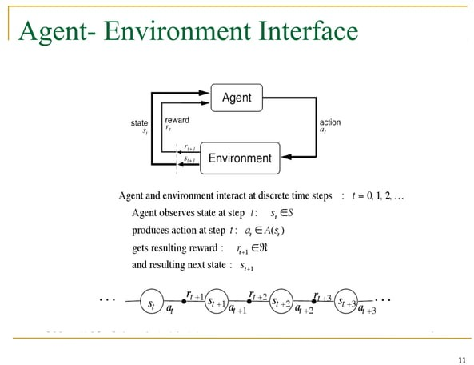
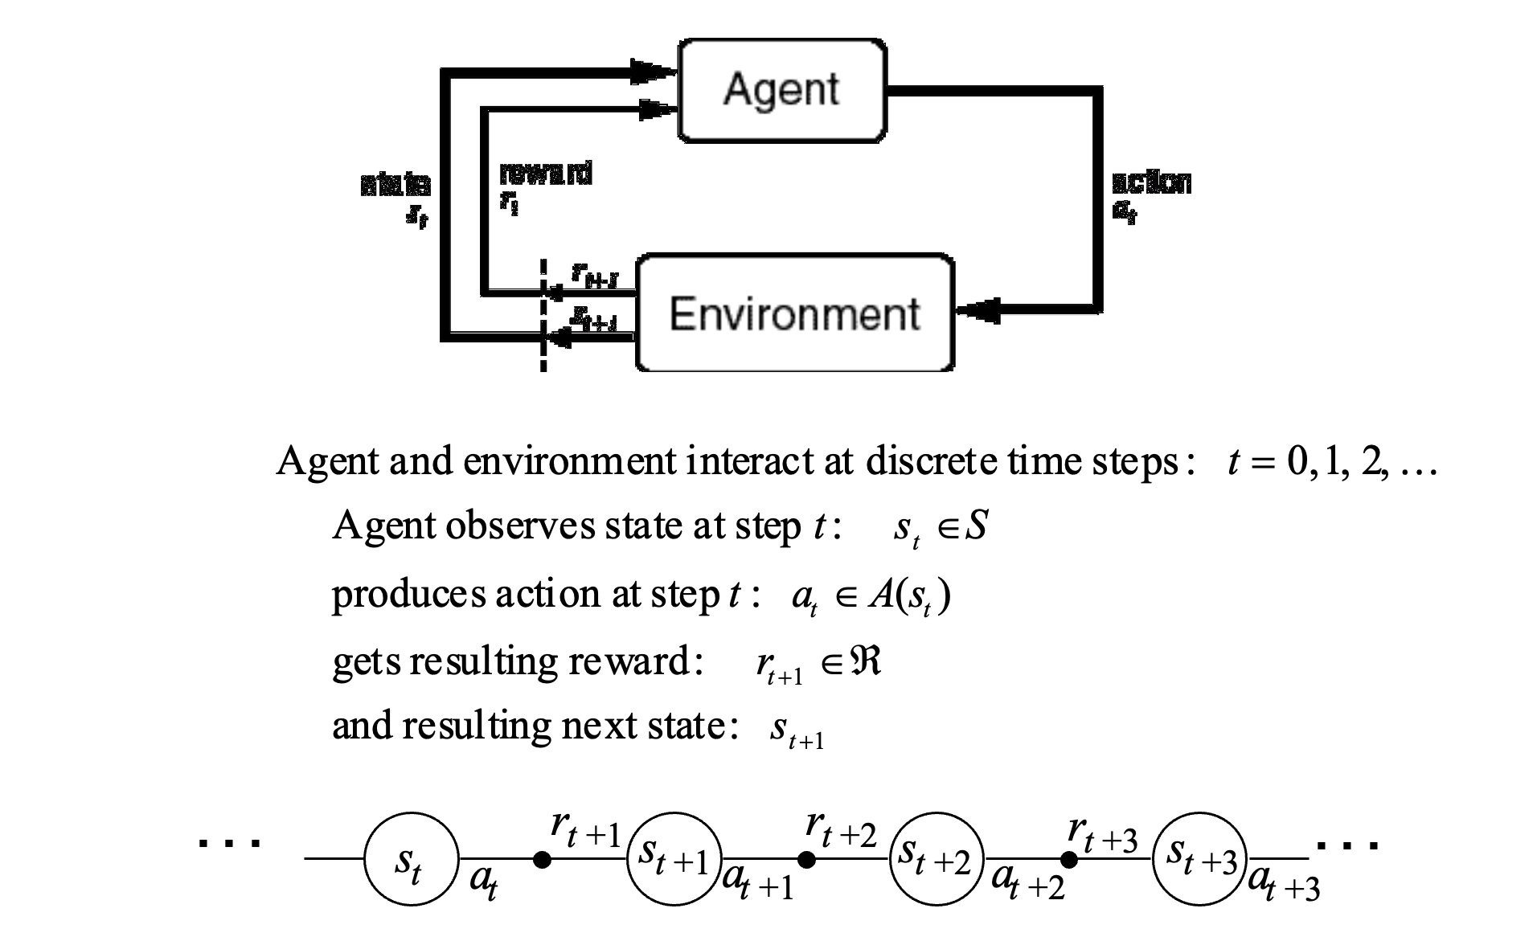
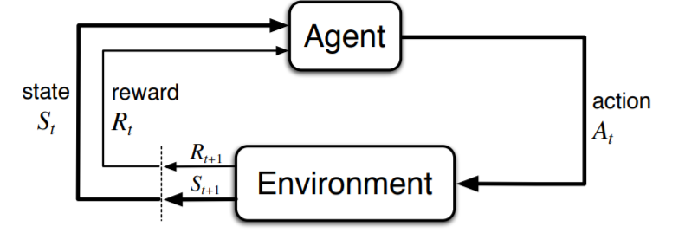

Slide 12
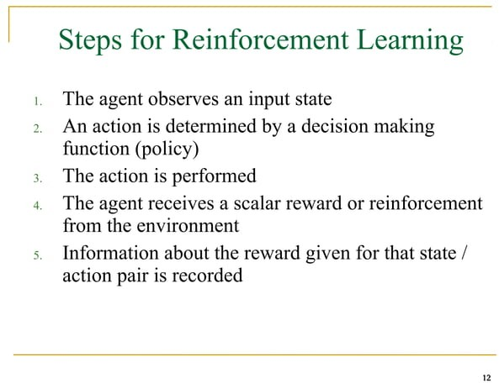

Slide 13
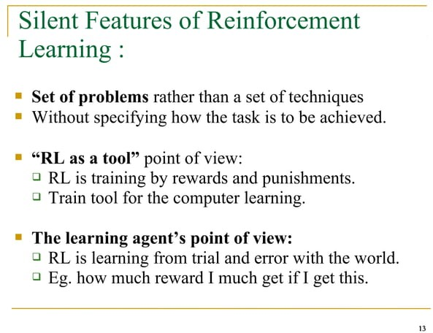

Slide 14
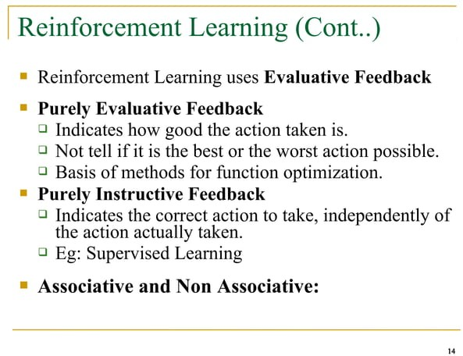

Slide 15
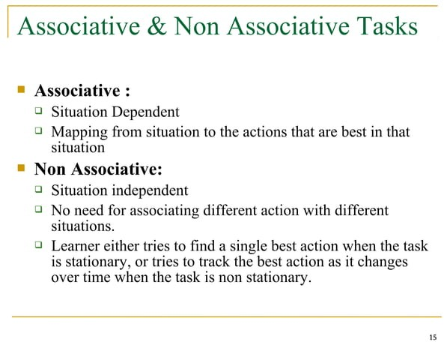

Slide 16
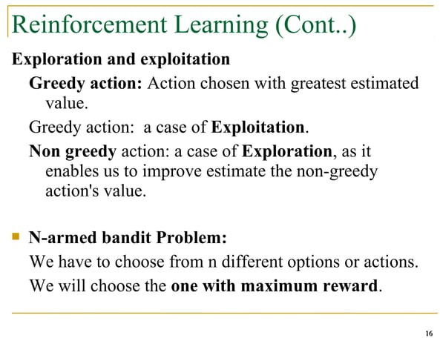


Slide 17
The Exploration/Exploitation Dilemma
Suppose you form estimates
The greedy action at t is
You can’t exploit all the time; you can’t explore all the time
You can never stop exploring; but you should always reduce exploring
action value estimates

Slide 18
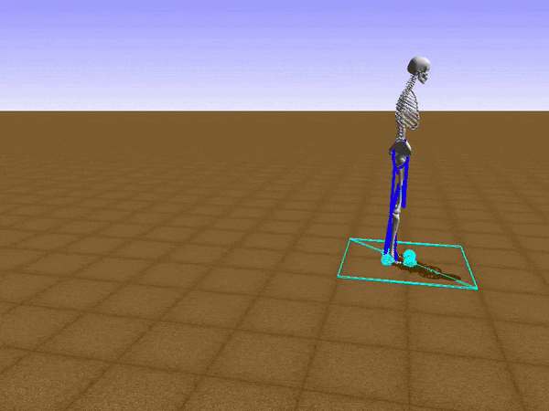
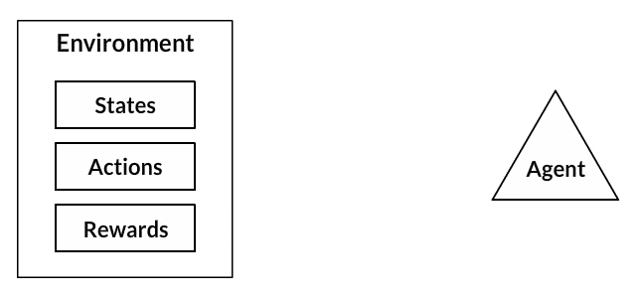

Slide 19
The Agent-Environment Relationship:
Agent : Software programs that make intelligent decisions and they are the learners in RL. These agents interact with the environment by actions and receive rewards based on these actions.
Environment: It is the demonstration of the problem to be solved. We can have a real-world environment or a simulated environment with which our agent will interact.
State : This is the position of the agents at a specific time-step in the environment. So, whenever an agent performs an action, the environment gives the agent a reward and a new state where the agent reached by performing the action.

Slide 20
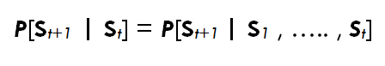
Transition : Moving from one state to another is called Transition (or state transition).
Transition Probability: The probability that the agent will move from one state, s to another state s’ is called transition probability, P_{ss’}.
The Markov Property states that :
“Future is Independent of the past given the present”
Mathematically we can express this statement as :

Slide 21
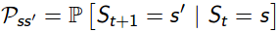
S_{t} denotes the current state of the agent and S_{t+1} denotes the next state. What this equation means is that the transition from state S_{t} to S_{t+1} is entirely independent of the past. So, the RHS of the Equation means the same as LHS if the system has a Markov Property. Intuitively meaning that our current state already captures the information of the past states.
State Transition Probability :
As we now know about transition probability we can define state transition probability as follows :
For Markov States from S_{t} to S_{t+1} i.e. any other successor state , the state transition probability is given by,

Slide 22
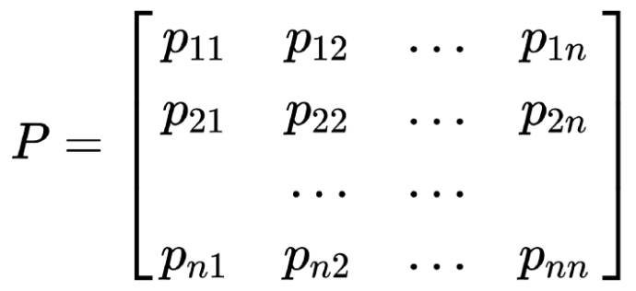
We can formulate the state transition probability into a state transition probability matrix by :
Each row in the matrix represents the probability from moving a particular state (starting state) to any successor state. Sum of each row is equal to 1.

Slide 23
Markov Process or Markov Chains
A Markov Process is the memoryless random process i.e. a sequence of random states S₁, S₂,….S_{n} with a Markov Property. So, it’s basically a sequence of states with the Markov Property. It can be defined using a set of states(S) and transition probability matrix (P).The dynamics of the environment can be fully defined using the States (S) and Transition Probability matrix (P).
But what random process means ?
To answer this question let’s look at an example:

Slide 24
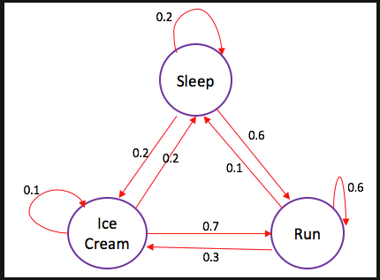
The edges of the tree denote transition probabilities. Now, suppose that we were sleeping and the according to the probability distribution there is a 0.6 chance that we will Run and 0.2 chance we sleep more and again 0.2 that we will eat ice-cream.

Slide 25
The Agent-Environment Interface

Slide 26
The Agent Learns a Policy
Reinforcement learning methods specify how the agent changes its policy as a result of experience.
Roughly, the agent’s goal is to get as much reward as it can over the long run.

Slide 27
Getting the Degree of Abstraction Right
Time steps need not refer to fixed intervals of real time.
Actions can be low level (e.g., voltages to motors), or high level (e.g., accept a job offer), “mental” (e.g., shift in focus of attention), etc.
States can be low-level “sensations”, or they can be abstract, symbolic, based on memory, or subjective (e.g., the state of being “surprised” or “lost”).
An RL agent is not like a whole animal or robot, which consist of many RL agents as well as other components.
The environment is not necessarily unknown to the agent, only incompletely controllable.
Reward computation is in the agent’s environment because the agent cannot change it arbitrarily.

Slide 28
Goals and Rewards
Is a scalar reward signal an adequate notion of a goal?—maybe not, but it is surprisingly flexible.
A goal should specify what we want to achieve, not how we want to achieve it.
A goal must be outside the agent’s direct control—thus outside the agent.
The agent must be able to measure success:
explicitly;
frequently during its lifespan.

Slide 29
Returns
Episodic tasks: interaction breaks naturally into episodes, e.g., plays of a game, trips through a maze.
where T is a final time step at which a terminal state is reached, ending an episode.

Slide 30
Returns for Continuing Tasks
Continuing tasks: interaction does not have natural episodes.
Discounted return:

Slide 31
An Example
Avoid failure: the pole falling beyond
a critical angle or the cart hitting end of
track.
As an episodic task where episode ends upon failure:
As a continuing task with discounted return:
In either case, return is maximized by
avoiding failure for as long as possible.

Slide 32
Another Example
Get to the top of the hill
as quickly as possible.
Return is maximized by minimizing
number of steps reach the top of the hill.

Slide 33
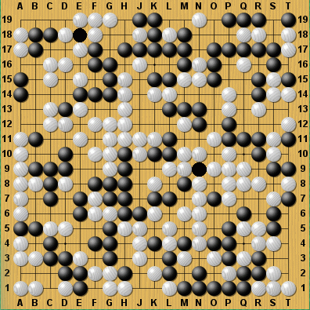
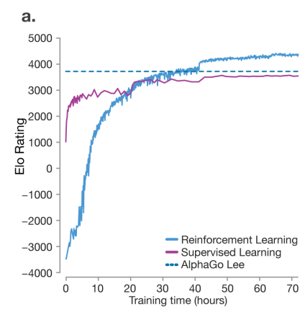
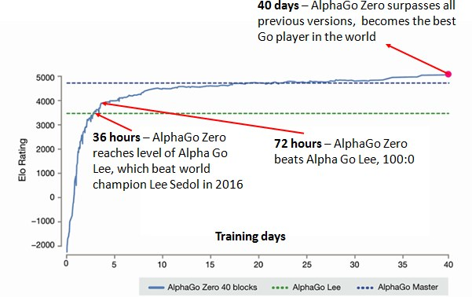
Alpha Go
State: Board State
Actions: Valid Moves
Reward: Win or Lose
Learning how to beat humans at ‘hard’ games (search space too big)
Far surpasses (Human) Supervised learning
Algorithm learned to outplay humans at chess in 24 hours
https://deepmind.com/documents/119/agz_unformatted_nature.pdf

Slide 34
How Reinforcement Learning is Different
Delayed Reward
Agent chooses training data
Explore vs Exploit (Life long learning)
Very different terminology (can be confusing)

Slide 35
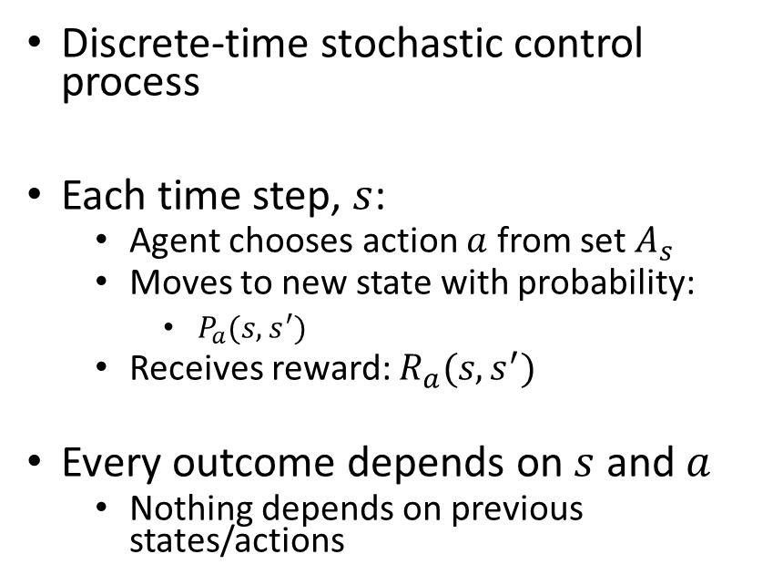
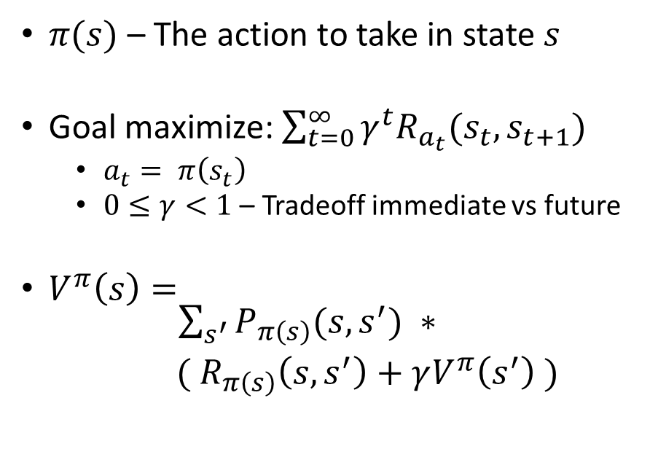
Setup for Reinforcement Learning
Markov Decision Process (environment)
Policy
(agent’s behavior)
Discrete-time stochastic control process
Each time step, $s$:
Agent chooses action $a$ from set $A_{s}$
Moves to new state with probability:
$P_{a}(s, s^{′})$
Receives reward: $R_{a}(s, s^{′})$
Every outcome depends on $s$ and $a$
Nothing depends on previous states/actions
$π(s)$ – The action to take in state $s$
Goal maximize:$\sum_{t=0}^{∞}{γ^{t}R_{a_{t}}(s_{t},s_{t+1})}$
$a_{t}= π\left(s_{t}\right)$
$0≤γ<1$ – Tradeoff immediate vs future
$V^{π}\left(s\right)= \begin{matrix}\sum_{s^{′}}{P_{π\left(s\right)}(s,s^{′})} ∗ \\ ({ R}_{π\left(s\right)}\left(s,s^{′}\right)+γV^{π}\left(s^{′}\right) )\end{matrix}$
Probability of moving to each state
Reward for making that move
Value of being in that state

Slide 36








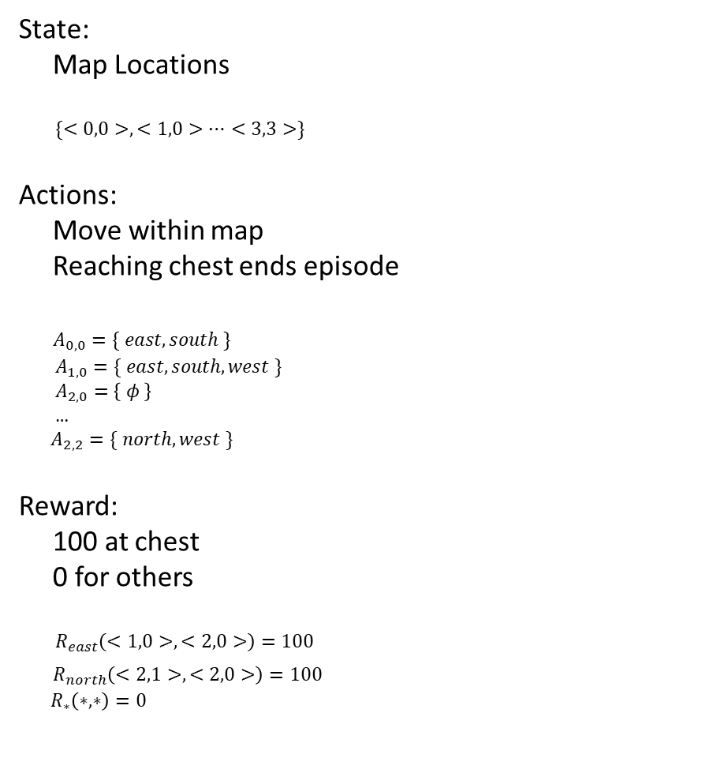
Simple Example of Agent in an Environment
State:
Map Locations
$\{<0,0>, <1,0>…<3,3>\}$
Actions:
Move within map
Reaching chest ends episode
$A_{0,0}=\{ east, south \}$
$A_{1,0}=\{ east, south, west \}$
$A_{2,0}=\left\{ φ \right\}$
…
$A_{2,2}=\{ north, west \}$
Reward:
100 at chest
0 for others
$R_{east}\left(<1,0>, <2,0>\right)=100$
$R_{north}\left(<2,1>, <2,0>\right)=100$
$R_{∗}\left(∗, ∗\right)=0$
Score: 0
Score: 100
0, 0
1, 0
2, 0
100
0, 1
1, 1
2, 1
0, 2
1, 2
2, 2

Slide 37
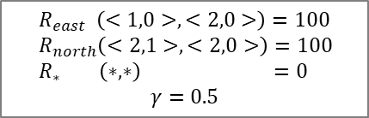
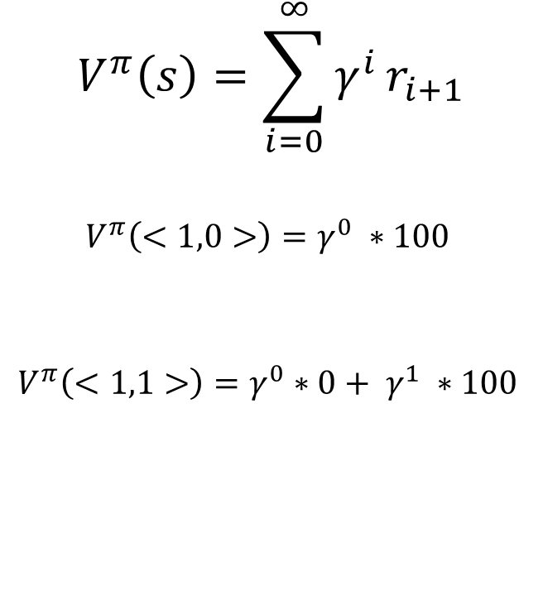
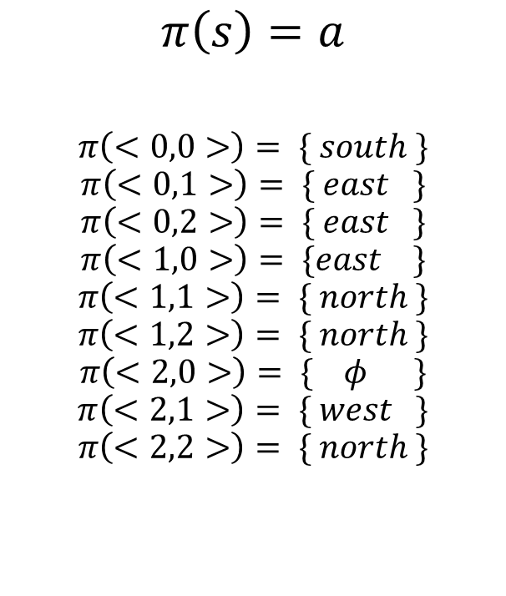
Policies
$R_{east} \left(<1,0>, <2,0>\right)=100$
$R_{north}\left(<2,1>, <2,0>\right)=100$
$R_{∗} \left(∗, ∗\right) =0$
$$γ=0.5$$
Policy
Evaluating Policies
$$π\left(s\right)=a$$
$$π\left(<0,0>\right)= \{ south \}$$
$$π\left(<0,1>\right)= \{ east \}$$
$$π\left(<0,2>\right)= \{ east \}$$
$$π\left(<1,0>\right)= \{east \}$$
$$π\left(<1,1>\right)= \{ north \}$$
$$π\left(<1,2>\right)= \{ north \}$$
$$π\left(<2,0>\right)= \{ φ \}$$
$$π\left(<2,1>\right)= \{ west \}$$
$$π\left(<2,2>\right)= \{ north \}$$
0, 0
1, 0
2, 0
$$V^{π}\left(s\right)=\sum_{i=0}^{∞}{γ^{i}}r_{i+1}$$
$$V^{π}\left(<1,0>\right)=γ^{0} ∗100$$
$$V^{π}\left(<1,1>\right)=γ^{0}∗0+ γ^{1} ∗100$$
12.5
100
0, 1
1, 1
2, 1
50
0, 2
1, 2
2, 2
Move to <0,1>
Move to <1,0>
Move to <1,1>
Move to <2,0>
$$V^{π}\left(<0,0>\right)=γ^{0}∗0+ γ^{1} ∗0+γ^{2} ∗0+γ^{3} ∗100$$
Policy could be better

Slide 38
The Markov Property
By “the state” at step t, the book means whatever information is available to the agent at step t about its environment.
The state can include immediate “sensations,” highly processed sensations, and structures built up over time from sequences of sensations.
Ideally, a state should summarize past sensations so as to retain all “essential” information, i.e., it should have the Markov Property:

Slide 39
Markov Decision Processes
If a reinforcement learning task has the Markov Property, it is basically a Markov Decision Process (MDP).
If state and action sets are finite, it is a finite MDP.
To define a finite MDP, you need to give:
state and action sets
one-step “dynamics” defined by transition probabilities:
reward probabilities:

Slide 40
Recycling Robot MDP

Slide 41
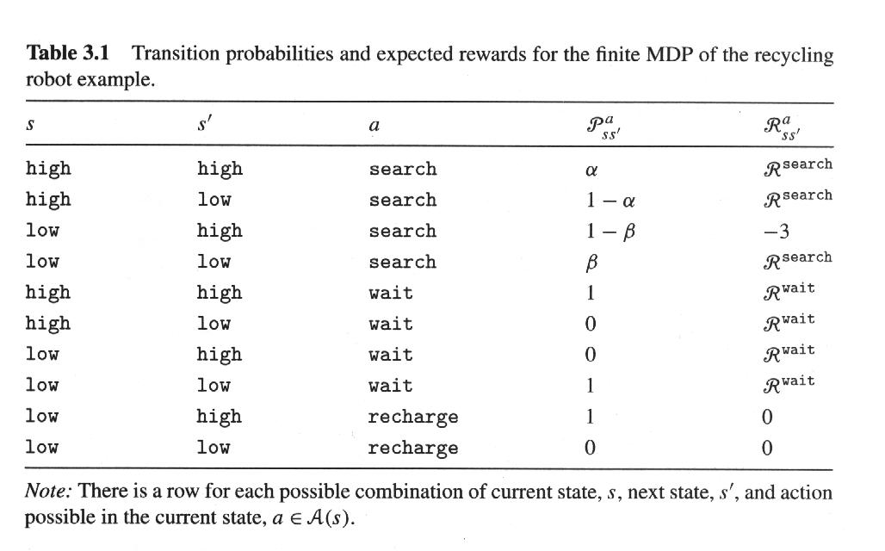
Transition Table

Slide 42
Value Functions
The value of a state is the expected return starting from that state; depends on the agent’s policy:
The value of taking an action in a state under policy π is the expected return starting from that state, taking that action, and thereafter following π :

Slide 43
Bellman Equation for a Policy π
The basic idea:
So:
Or, without the expectation operator:

Slide 44
Gridworld
Actions: north, south, east, west; deterministic.
If would take agent off the grid: no move but reward = –1
Other actions produce reward = 0, except actions that move agent out of special states A and B as shown.
State-value function
for equiprobable
random policy;
γ = 0.9

Slide 45
Optimal Value Functions
For finite MDPs, policies can be partially ordered:
There is always at least one (and possibly many) policies that is better than or equal to all the others. This is an optimal policy. We denote them all π *.
Optimal policies share the same optimal state-value function:
Optimal policies also share the same optimal action-value function:
This is the expected return for taking action a in state s and thereafter following an optimal policy.

Slide 46
Bellman Optimality Equation for V*
The value of a state under an optimal policy must equal the expected return for the best action from that state:
The relevant backup diagram:
is the unique solution of this system of nonlinear equations.

Slide 47
Bellman Optimality Equation for Q*
The relevant backup diagram:
is the unique solution of this system of nonlinear equations.

Slide 48
Why Optimal State-Value Functions are Useful
Any policy that is greedy with respect to is an optimal policy.
Therefore, given , one-step-ahead search produces the long-term optimal actions.
E.g., back to the gridworld:

Slide 49
What About Optimal Action-Value Functions?
Given , the agent does not even have to do a one-step-ahead search:

Slide 50
Grid World
The agent lives in a grid
Walls block the agent’s path
The agent’s actions do not always go as planned:
80% of the time, the action North takes the agent North (if there is no wall there)
10% of the time, North takes the agent West; 10% East
If there is a wall in the direction the agent would have been taken, the agent stays put
Small “living” reward each step
Big rewards come at the end
Goal: maximize sum of rewards*

Slide 51
Grid Futures
Deterministic Grid World
Stochastic Grid World
 | X
 | X
E N S W
E N S W
?
 | X
X
 | X
 |  | X

Slide 52
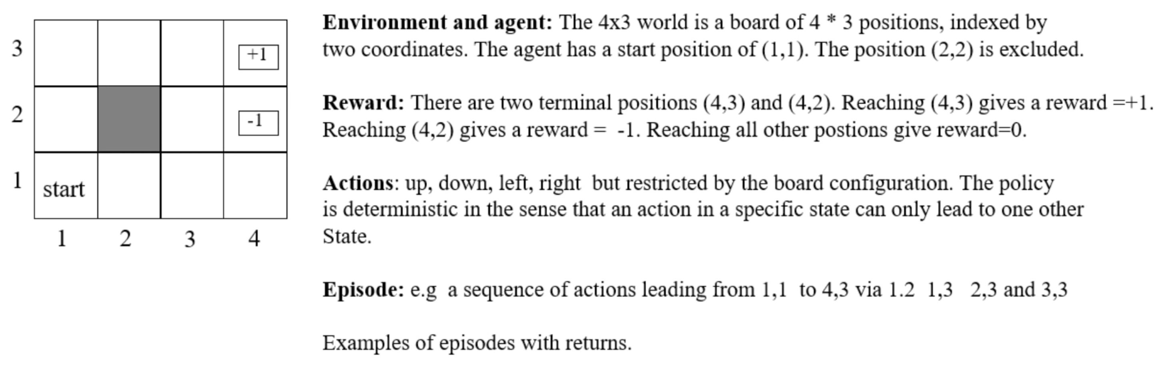
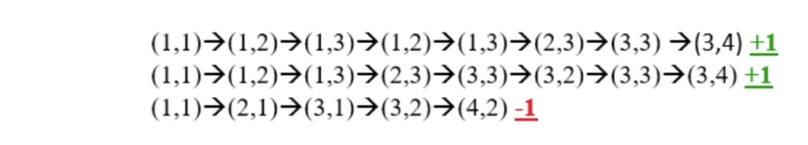

Slide 53
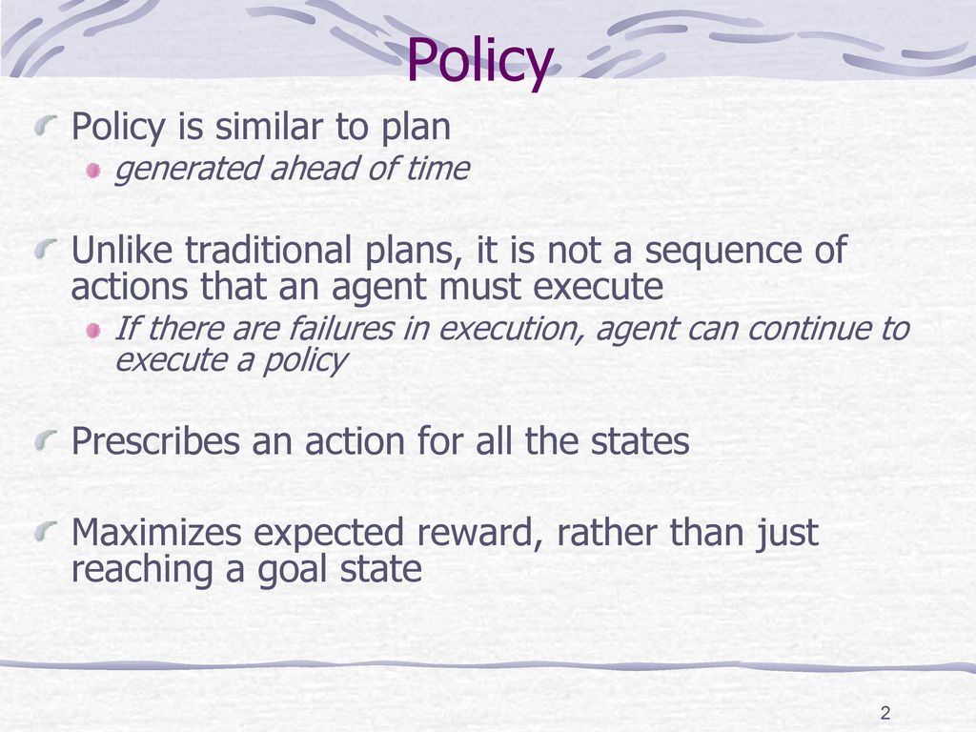

Slide 54
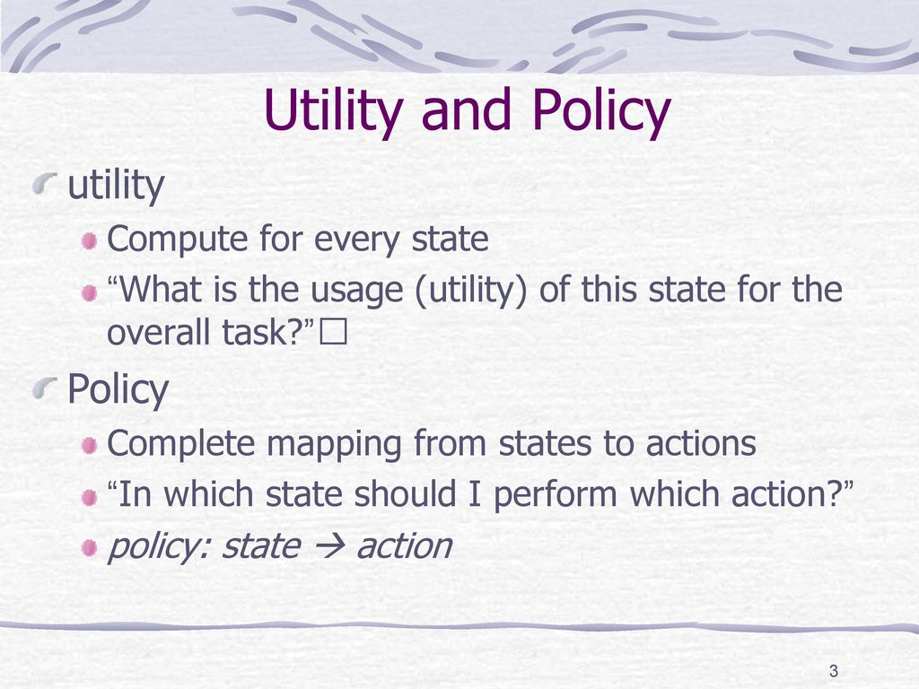

Slide 55
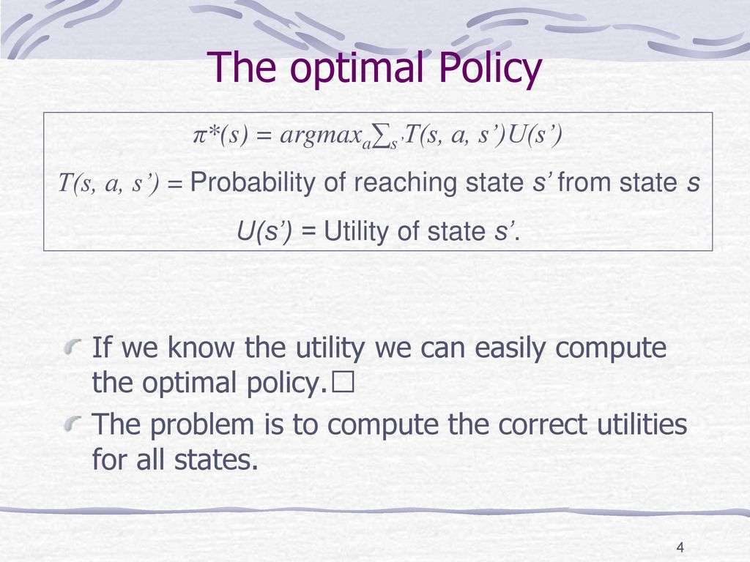

Slide 56
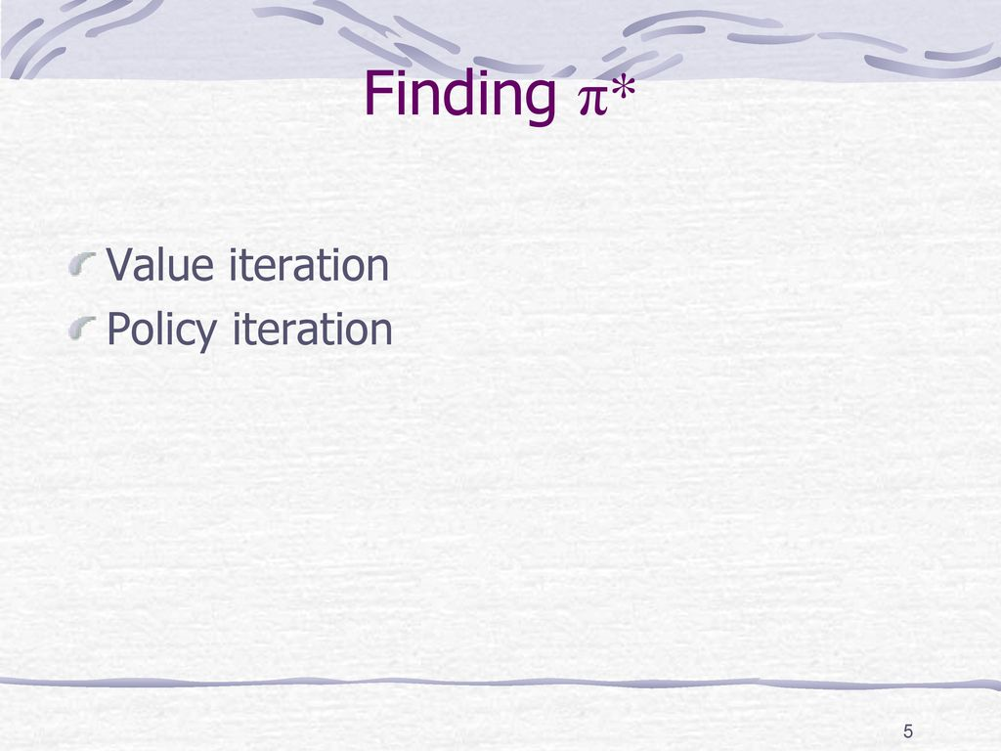

Slide 57
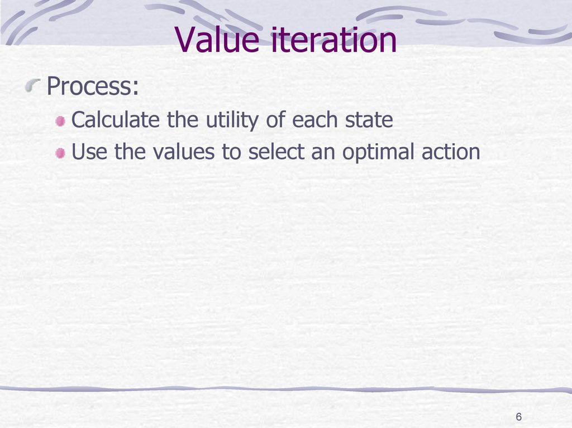

Slide 58
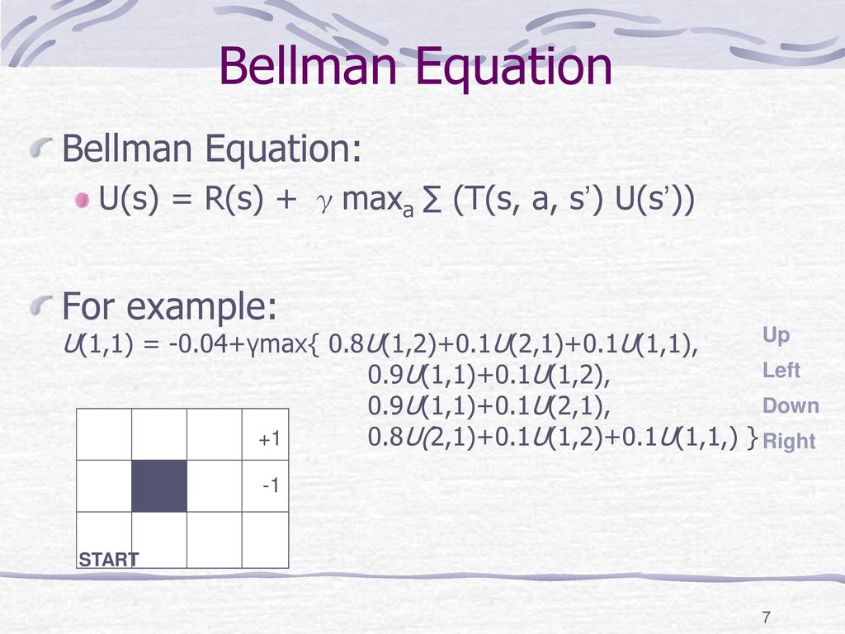

Slide 59
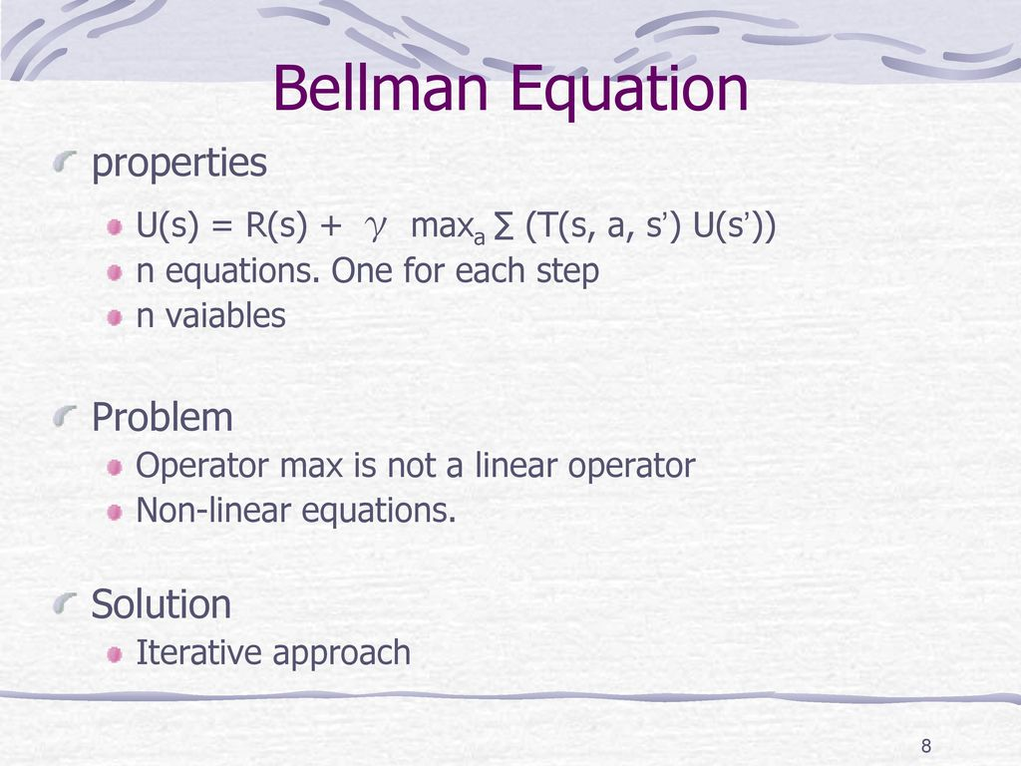

Slide 60
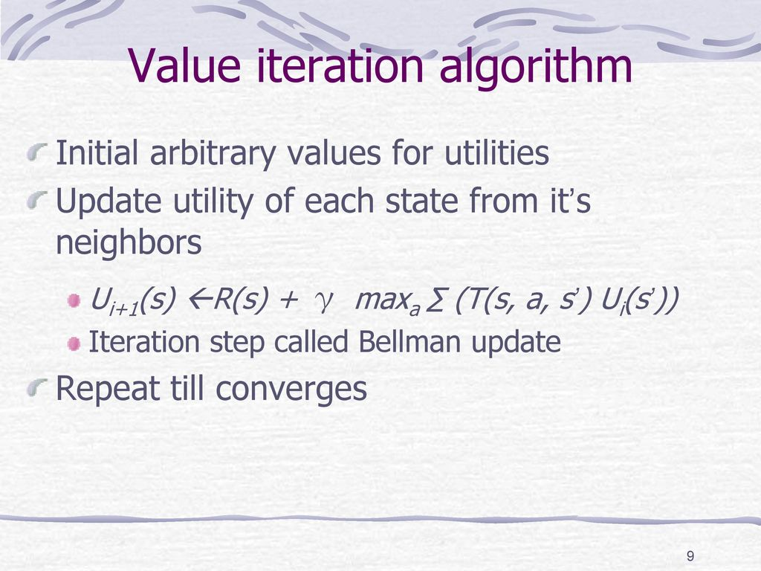

Slide 61
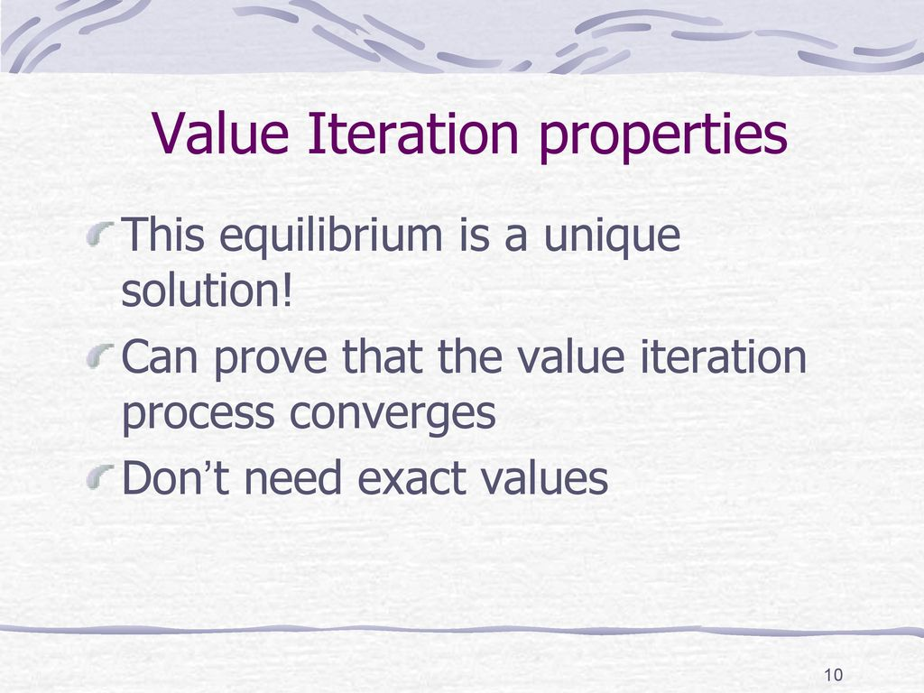

Slide 62
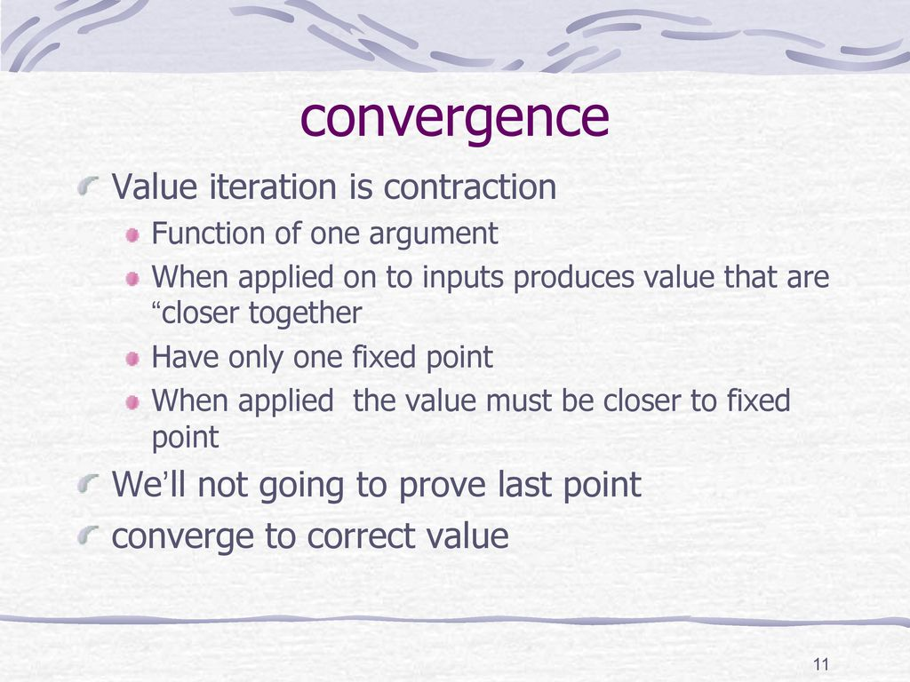

Slide 63
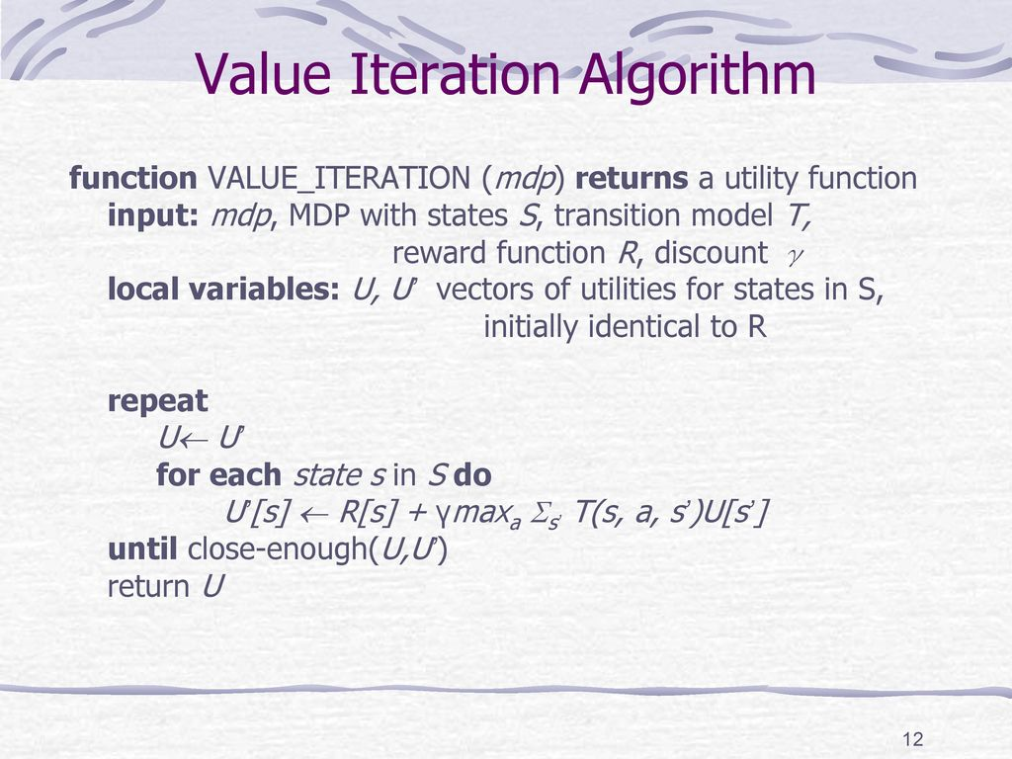

Slide 64
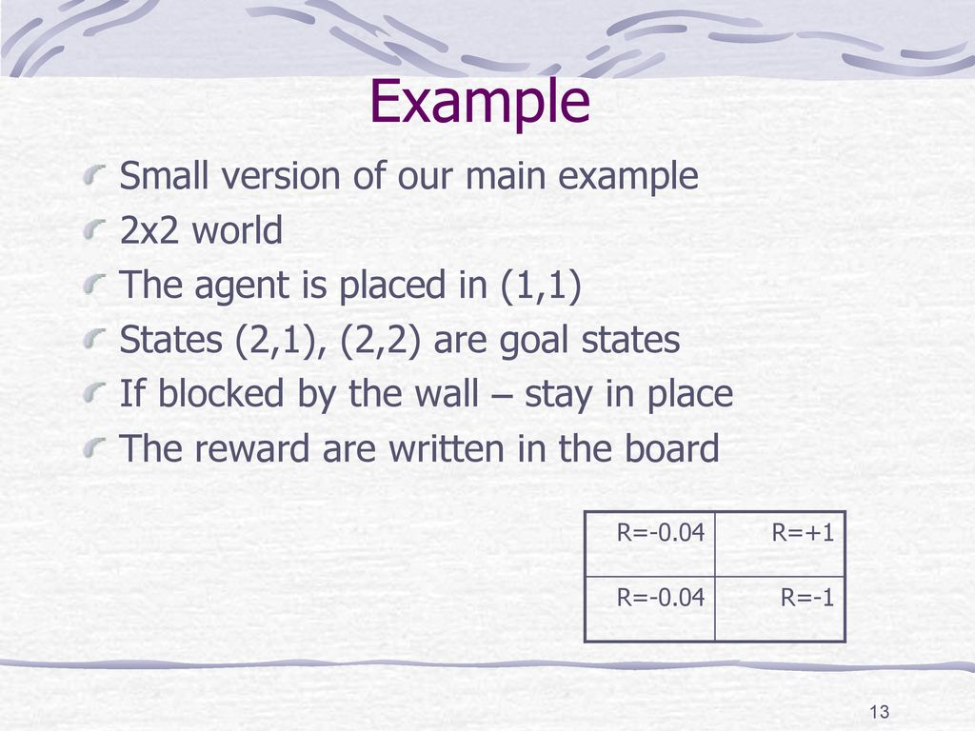

Slide 65
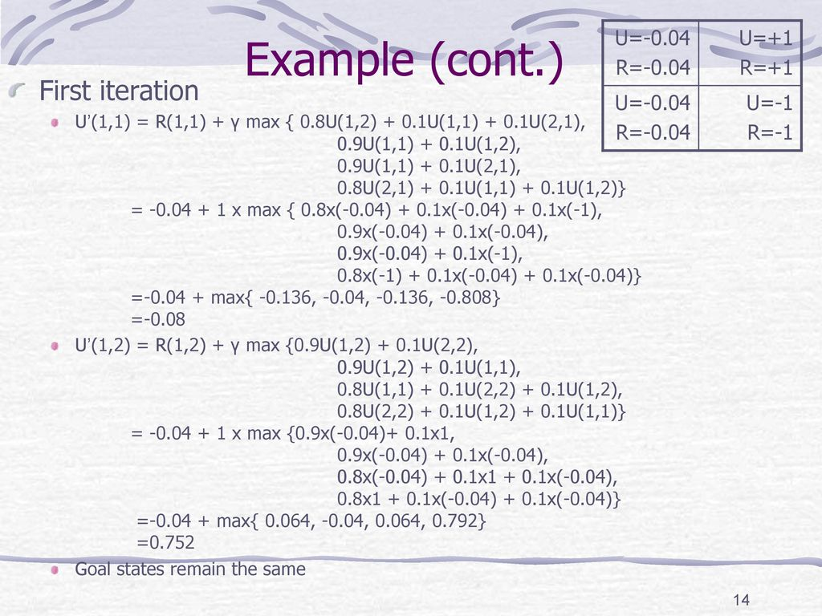

Slide 66
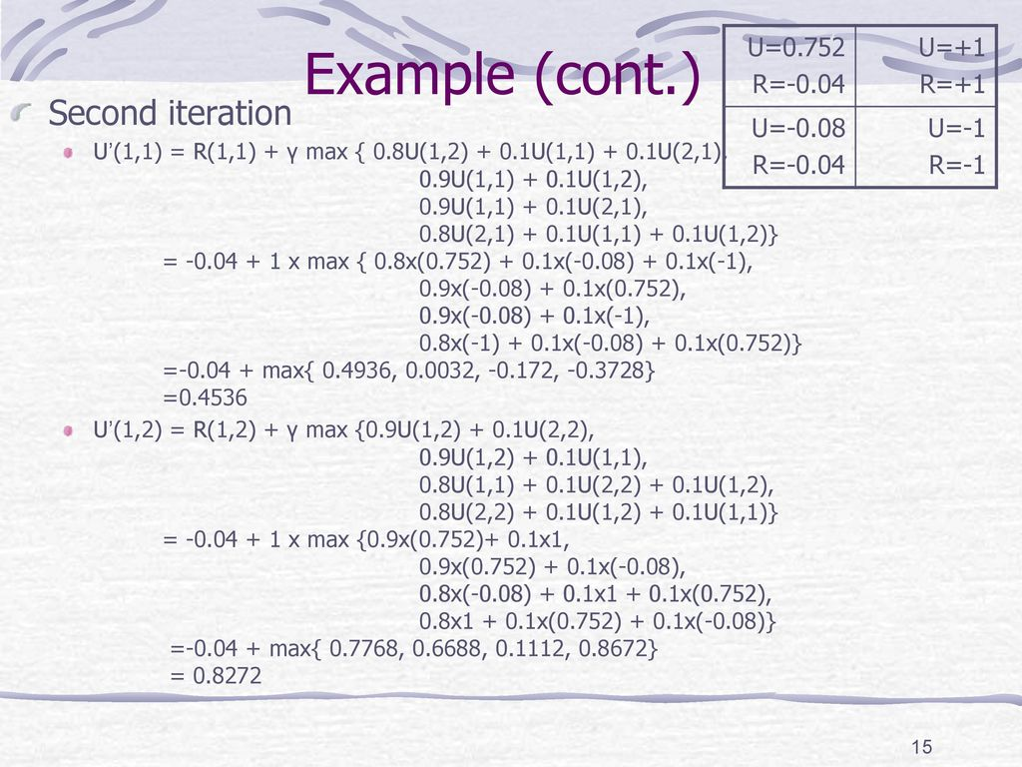

Slide 67
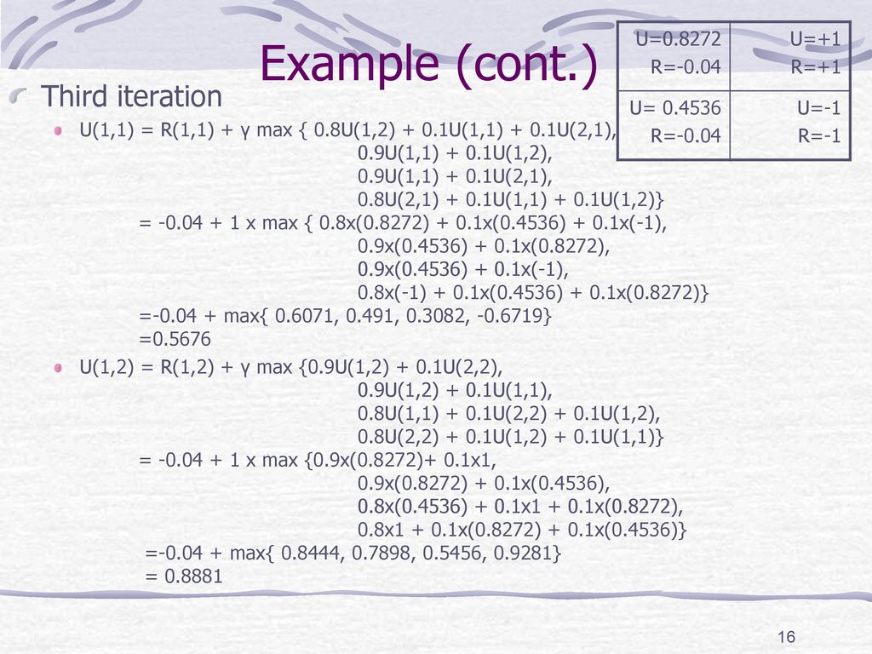

Slide 68


Slide 69


Slide 70


Slide 71


Slide 72


Slide 73


Slide 74


Slide 75


Slide 76


Slide 77


Slide 78


Slide 79


Slide 80


Slide 81


Slide 82


Slide 83


Slide 84


Slide 85


Slide 86


Slide 87



Slide 88



Slide 89



Slide 90



Slide 91


Slide 92

Bellman Equation for Value Function
Bellman Equation helps us to find optimal policies and value functions. We know that our policy changes with experience so we will have different value functions according to different policies.
Optimal value function is one which gives maximum value compared to all other value functions.
Bellman Equation states that value function can be decomposed into two parts:
Immediate Reward, R[t+1] and Discounted value of successor states. Mathematically, we can define Bellman Equation as :
We want to know the value of state s. The value of state (s) is the reward we got upon being in that state, plus the discounted value of the state we landed upon.

Slide 93

What is a Markov Decision Process (MDP) ?
Markov Decision Process : It is Markov Reward Process with decisions. Everything is same like MRP but now we have actual agency that makes decisions or take actions.
It is a tuple of (S, A, P, R, 𝛾) where:
S is a set of states,
A is the set of actions agent can choose to take,
P is the transition Probability Matrix,
R is the Reward accumulated by the actions of the agent,
𝛾 is the discount factor.
P and R will have slight changes w.r.t actions as follows :

Slide 94


Transition Probability:
Reward Function:
Now, our reward function is dependent on the action. Till now we have talked about getting a reward (R) when our agent goes through a set of states (s) following a policy π. Actually, in Markov Decision Process(MDP) the policy is the mechanism to take decisions . So now we have a mechanism which will choose to take an action.

Slide 95

Policies in an MDP depends on the current state. They do not depend on the history. That’s the Markov Property. So, the current state we are in characterizes the history.
We have already seen how good it is for the agent to be in a particular state (State-value function). Now, let’s see how good it is to take a particular action following a policy π from state s (Action-Value Function).
The Bellman Expectation equation under a policy π can be stated as:
The above equation tells us that the value of a particular state is determined by the immediate reward plus the value of successor states when we are following a certain policy (π).

Slide 96

State-action value function or Q-Function:
This function specifies the how good it is for the agent to take action (a) in a state (s) with a policy π. This function can be mathematically expressed as:
Basically, it tells us the value of performing a certain action(a) in a state(s) with a policy π.

Slide 97

Similar to V_{π}(s), we can express our state-action Value function (Q-Function) as follows :
From the above equation, we can see that the State-Action Value of a state can be decomposed into the immediate reward we get on performing a certain action in state(s) and moving to another state(s’) plus the discounted value of the state-action value of the state(s’) with respect to the some action(a) our agent will take from that state on-wards.
Now, let’s go deeper into Bellman Expectation Equation:
Consider the diagram on the right. From the state s, we
Take several actions with some probability distribution.
There is a Q-value(State-action value function) for each
of the action. Now, we can average the Q-values which
tells us how good it is to be in a particular state.
Basically, it defines V_{π}(s)

Slide 98


This equation also tells us the connection between State-Value function and State-Action Value Function.
Now, let’s look at the following diagram for State-Action Value Function:
This diagram says that suppose we start off by taking some action (a). So, because of the action (a) the agent might move into any of neigbour states in the environment. Now: how good it is to take action(a)?
We again average the state-values of neighbour states, added with an immediate reward which tells us how good it is to take a particular action (a).This defines the q_{π}(s,a).

Slide 99


Mathematically, this can be expressed as follows :
where P is the Transition Probability Matrix .
Now let’s stitch these backup diagrams together to define State-Value Function, Vπ(s):
Note that the probability of the action the agent might take from state s is weighted by our policy and after taking that action the probability that we land in any of the states(s’) is weighted by the environment.

Slide 100

Now our question is, how good it is to be in state(s) after taking some action and landing on another state(s’) and following our policy(π) after that?
It is similar to what we have done before, we are going to average the value of successor states(s’) with some transition probability(P) weighted with our policy.
Mathematically, we can define it as follows:

Slide 101

Now, let’s do the same for State-Action Value Function, q_{π}(s,a) :
It’s very similar to what we did in State-Value Function, so this diagram basically says that our agent take some action (a) because of which the environment might land us on any of the states (s’), then from that state we can choose to take any actions (a’) weighted with the probability of our policy (π). Again, we average them together and that gives us how good it is to take a particular action following a particular policy (π) all along.

Slide 102

Mathematically, this can be expressed as :
So, this is how we can formulate Bellman Expectation Equation for a given MDP to find it’s State-Value Function and State-Action Value Function.
But, it does not tell us the best way to behave in an MDP.
For that let’s talk about what is meant by Optimal Value and Optimal Policy Function.

Slide 103

Optimal Value Function
In an MDP environment, there are many different value functions according to different policies. The optimal Value function is one which yields maximum value compared to all other value function. When we say we are solving an MDP it actually means we are finding the Optimal Value Function.
So, mathematically Optimal State-Value Function can be expressed as :
In the above formula, v∗(s) tells us what is the maximum reward we can get from the system.

Slide 104

Defining Optimal State-Action Value Function (Q-Function)
Similarly, Optimal State-Action Value Function tells us the maximum reward we are going to get if we are in state s and taking action a from there on-wards.
Mathematically, It can be defined as :
Optimal State-Value Function :It is the maximum Value function over all policies.
Optimal State-Action Value Function: It is the maximum action-value function over all policies.

Slide 105

Optimal Policy
Before we define Optimal Policy, let’s know, what is meant by one policy better than other policy?
We know that for any MDP, there is a policy (π) better than any other policy (π’). But How?
We say that one policy (π) is better than other policy (π’) if the value function with the policy π for all states is greater than the value function with the policy π’ for all states. Intuitively, it can be expressed as :

Slide 106

Now, let’s define Optimal Policy :
Optimal Policy is one which results in optimal value function.
Note that, there can be more than one optimal policy in a MDP. But, all optimal policies achieve the same optimal value function and optimal state-action Value Function(Q-function).
Now, the question arises how we find Optimal Policy.
We find an optimal policy by maximizing over q*(s, a) i.e. our optimal state-action value function. We solve q*(s,a) and then we pick the action that gives us most optimal state-action value function (q*(s,a)). That is:

Slide 107

That is, for a state s we pick the action a with probability 1, if it gives us the maximum q*(s,a). So, if we know q*(s,a) we can get an optimal policy from it.
Let’s consider the following example:
In this example, the red arcs are the optimal policies which means that if our agent follows this path it will yield maximum reward from this MDP. Also, by seeing the q* values for each state we can say the actions our agent will take that yields maximum reward. So, optimal policy always takes action with higher q* value (State-Action Value Function). For example, in the state with value 8, there is q* with value 0 and 8. Our agent chooses the one with greater q* value i.e. 8.

Slide 108

Now, the question arises, How do we find these q*(s,a) values ?
This is where Bellman Optimality Equation comes into play.
Bellman Optimality equation is the same as Bellman Expectation Equation but the only difference is instead of taking the average of the actions our agent can take the action with the max value.
Let’s look at the Backup diagram:
Suppose our agent is in state s and from that state it can take two actions. So, we look at the action-values for each of the actions and our agent takes the action with greater q* value. This gives us the value of being in the state s.

Slide 109



Hence, mathematically, the Bellman optimality equation for state-value function is
Similarly, let’s define Bellman Optimality Equation for State-Action Value Function (Q-Function):
Suppose, our agent has taken an action a in some state s. We still take the average of the values of both the states, but the only difference is in Bellman Optimality Equation, we know the optimal values of each of the states:

Slide 110


Let’s again stitch these backup diagrams for State-Value Function :
Suppose our agent is in state s and from that state it took some action (a) where the probability of taking that action is weighted by the policy. And because of the action (a), the agent might get blown to any of the states(s’) where probability is weighted by the environment. In order to find the value of state s we simply average the Optimal values of the states (s’). This gives us the value of being in state s.
The max in the equation is because we are maximizing the actions the agent can take in the upper arcs. This equation also shows how we can relate V* function to itself.

Slide 111


Now, let’s look at the Bellman Optimality Equation for State-Action Value Function, q*(s,a) :
Suppose, our agent was in state s and it took some action (a). Because of that action, the environment might land our agent to any of the states (s’) and from these states we get to maximize the action our agent will take i.e. choosing the action with maximum q* value. We back that up to the top and that tells us the value of the action a.
Mathematically, this can be expressed as :

Slide 112

Let’s look at the following example to understand it better :
Look at the red arrows, suppose we wish to find the value of state with value 6 (in red), as we can see we get a reward of -1 if our agent chooses Facebook and a reward of -2 if our agent choose to study. In order to find the value of state in red, we will use the Bellman Optimality Equation for State-Value Function i.e. considering the other two states have optimal value we are going to take an average and maximize for both the action (choose the one that gives maximum value). So, from the diagram we can see that going to Facebook yields a value of 5 for our red state and going to study yields a value of 6 and then we maximize over the two which gives us 6 as the answer.

Slide 113
Now, how do we solve Bellman Optimality Equation for large MDPs. In order to do so we use Dynamic Programming algorithms like Policy iteration and Value iteration.
What is Dynamic Programming?
Dynamic Programming is a lot like divide and conquer approach which is breaking down a problem into sub-problems but the only difference is instead of solving them independently (like in divide and conquer), results of a sub-problem are used in similar sub-problems.
A problem can be solved using dynamic programming if it satisfies two properties:

Slide 114
Optimal Substructure: This means that a problem can be divided into sub-problems and if we find optimal solutions to those sub-problems, then we can use this optimal solution to find an optimal solution for the overall problem.
Overlapping Sub-problems: Being said before, Dynamic Programming is used if a problem has similar sub-problems. The solution of one sub-problem is saved and then used to solve similar sub-problems.
Do Markov Decision Process have these two properties?

Slide 115
For the first property, recall, Bellman equation is defined as follows:
Remember what the Bellman Equation said: the value of a state is equal to the immediate reward our agent gets leaving the state plus the value of the next state. So, the equation is breaking down the process of finding the value function of a state by dividing it into sub-problems.
For overlapping sub-problems, we have Value functions. Value functions have already stored how good a particular state is so we don’t need to recompute the value of that state again and again. For example, suppose there are two states(s1 and s2) and we are in state s1 and we have already computed the value of state s2 so when calculating the value of state s1 we will not re-compute the value of state s2. (The value of s1 relies on state s2)

Slide 116
What we mean when we say we are going to solve a Markov Decision Process?
It means that we are going to find the Value Function that will satisfy the Bellman Equation. Once we have found the optimal value function, then we can use it to find the optimal policy.
This process is broken down into two parts:
Prediction: Suppose we have a Markov Decision Process defined as (S, A, P, R, γ) and given some policy π. Our job in prediction is to find the value function. We find the value function by evaluating a policy using the Bellman Expectation Equation.
Control: This process involves optimizing the value function, we calculated during the prediction process. We find optimal value function and optimal policy for our Markov Decision Process.

Slide 117

Policy Evaluation
Synchronous Backups: It means that we are going to take into consideration every state in our Markov Decision Process for calculating the value of a state.
Policy Evaluation means how much reward our agent is going to get by following a particular policy π. But how we evaluate a policy π?
We evaluate a given policy π using Bellman Expectation Equation. Recall that, Bellman Expectation Equation tells how much reward our agent is going to get following a policy π and is defined as:
Initially we start with our value function of each state initialize to zero.

Slide 118

Now, to evaluate a policy we are going to use this equation in an iterative fashion. Meaning, we will calculate the value of the next state by backing up the value of the current state from the previous iteration. Lets understand this with an example:
We know that the value of the root node [s] is given by the reward we got by taking the action [a] plus the value of the state [s’]. Now, what we are doing is we are using the Bellman Expectation equation in an iterative fashion for dynamic programming. That is, we will use the value of the leaves (state [s’] here) which is from the previous iteration, when we were computing the value of state s, to calculate the value of the state [s]. This happens in every iteration. Now, for the second iteration, we are going to use the value of state we computed in the previous iteration that is v [k+1] to compute the value of the next state, that is, v [k+2].

